Slide 1
Flacco – Expensive Features
Data Analytics 1 – Case Study Group 03

Slide 2

Visualization
Image: https://www.salesscreen.com/theartofsales/data-visualization/

Slide 3
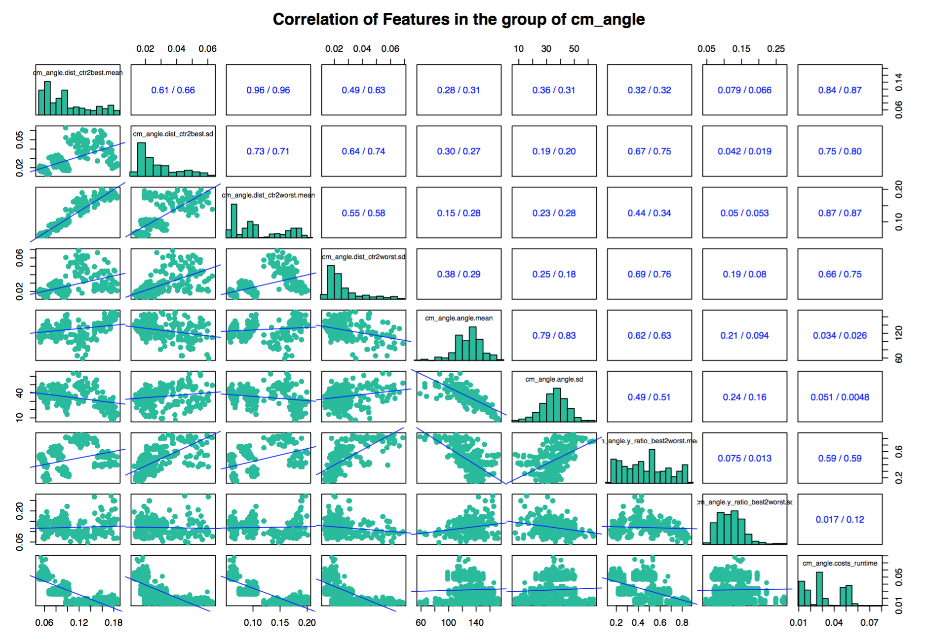
VIsualization
Scatterplots of cm_angle features
The highest correlation
dist_ctr2best.mean <> dist_ctr2wort.mean
Correlation between costs.runtime and dist feastures
dist feastures like dist_crt2best.mean have negative correlation with costs.runtime

Slide 4
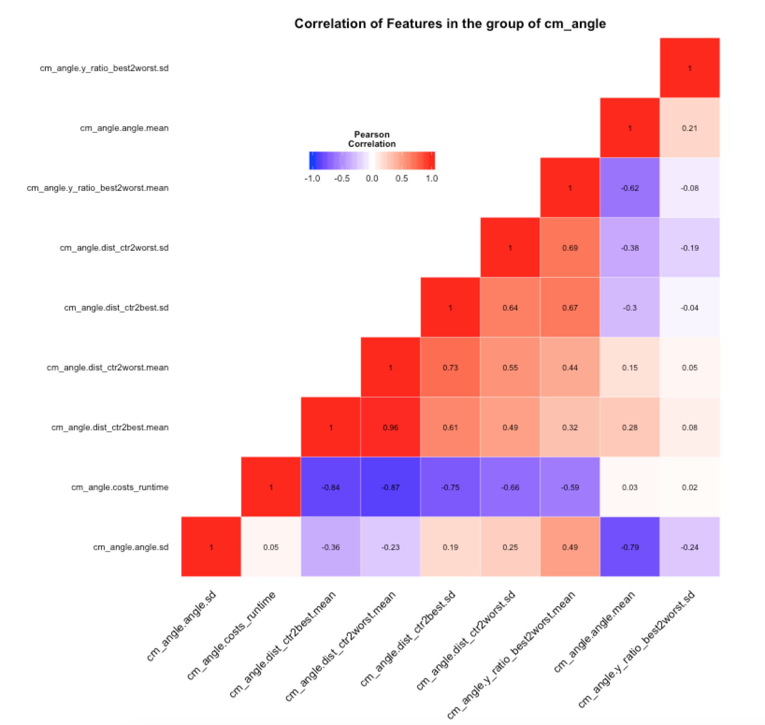
VIsualization
Ggheatmap of cm_angle features

Slide 5
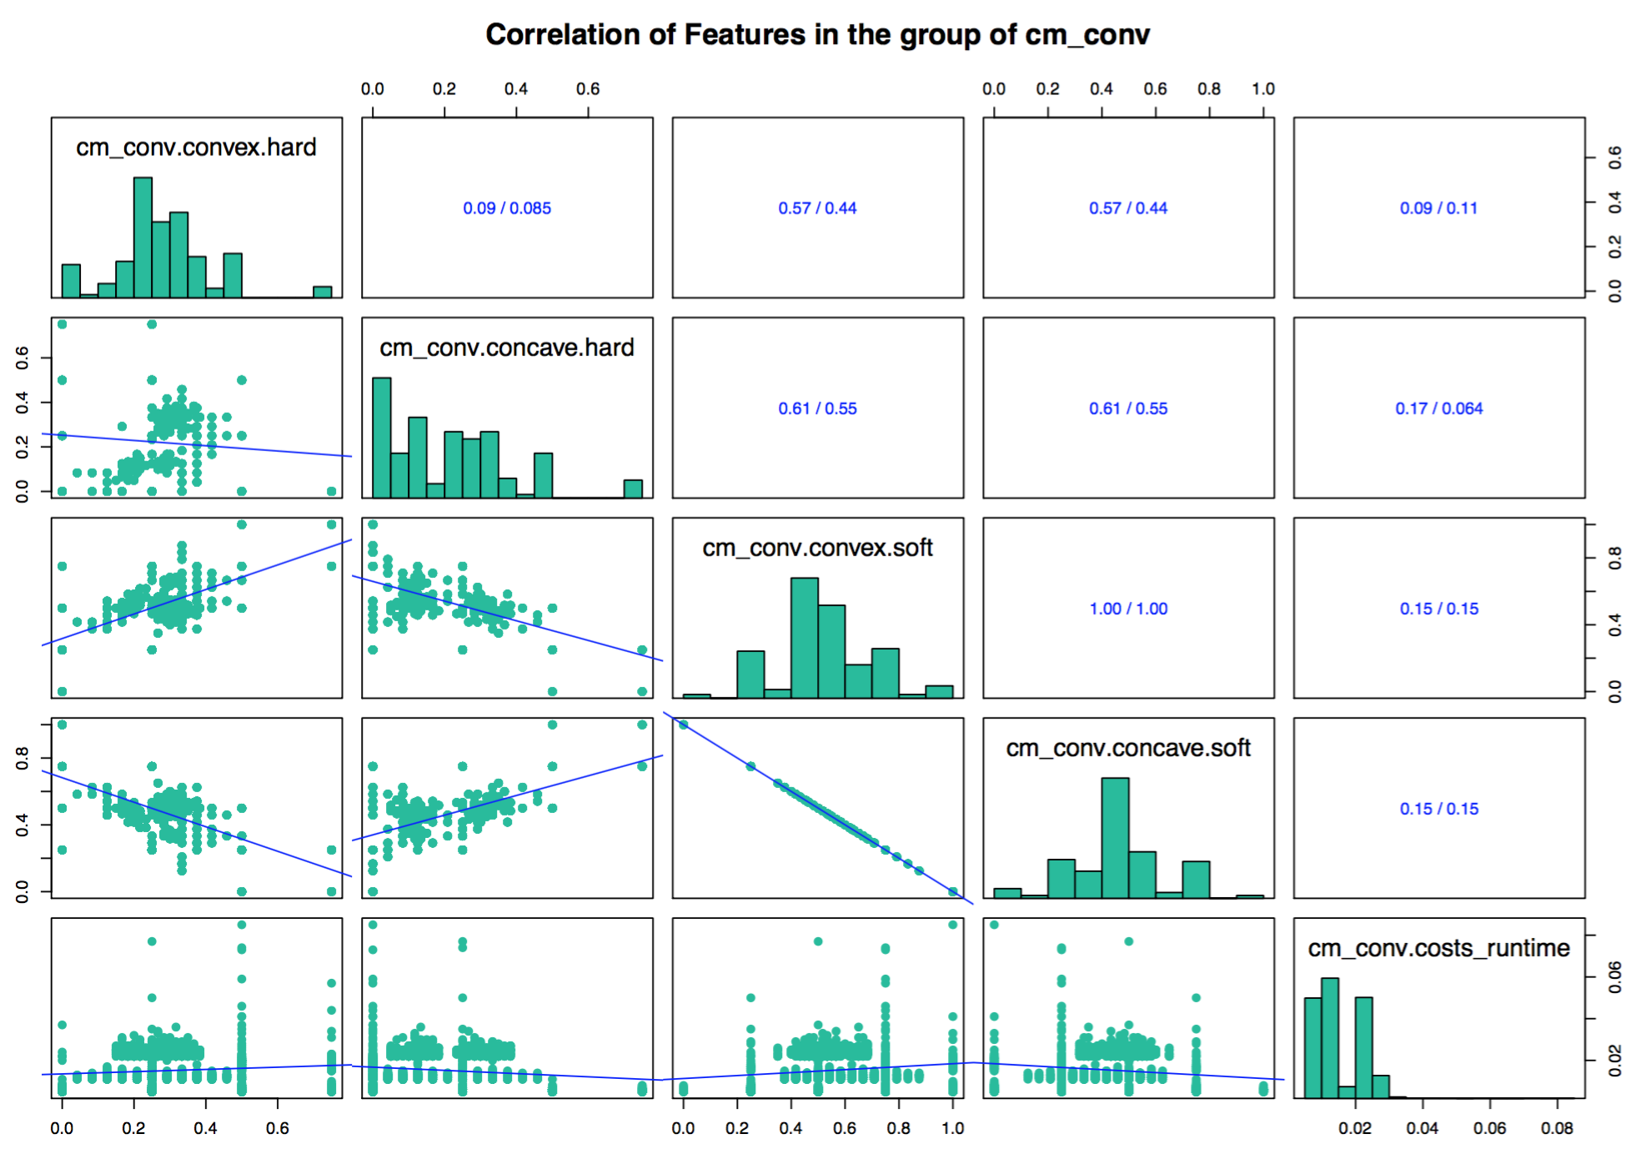
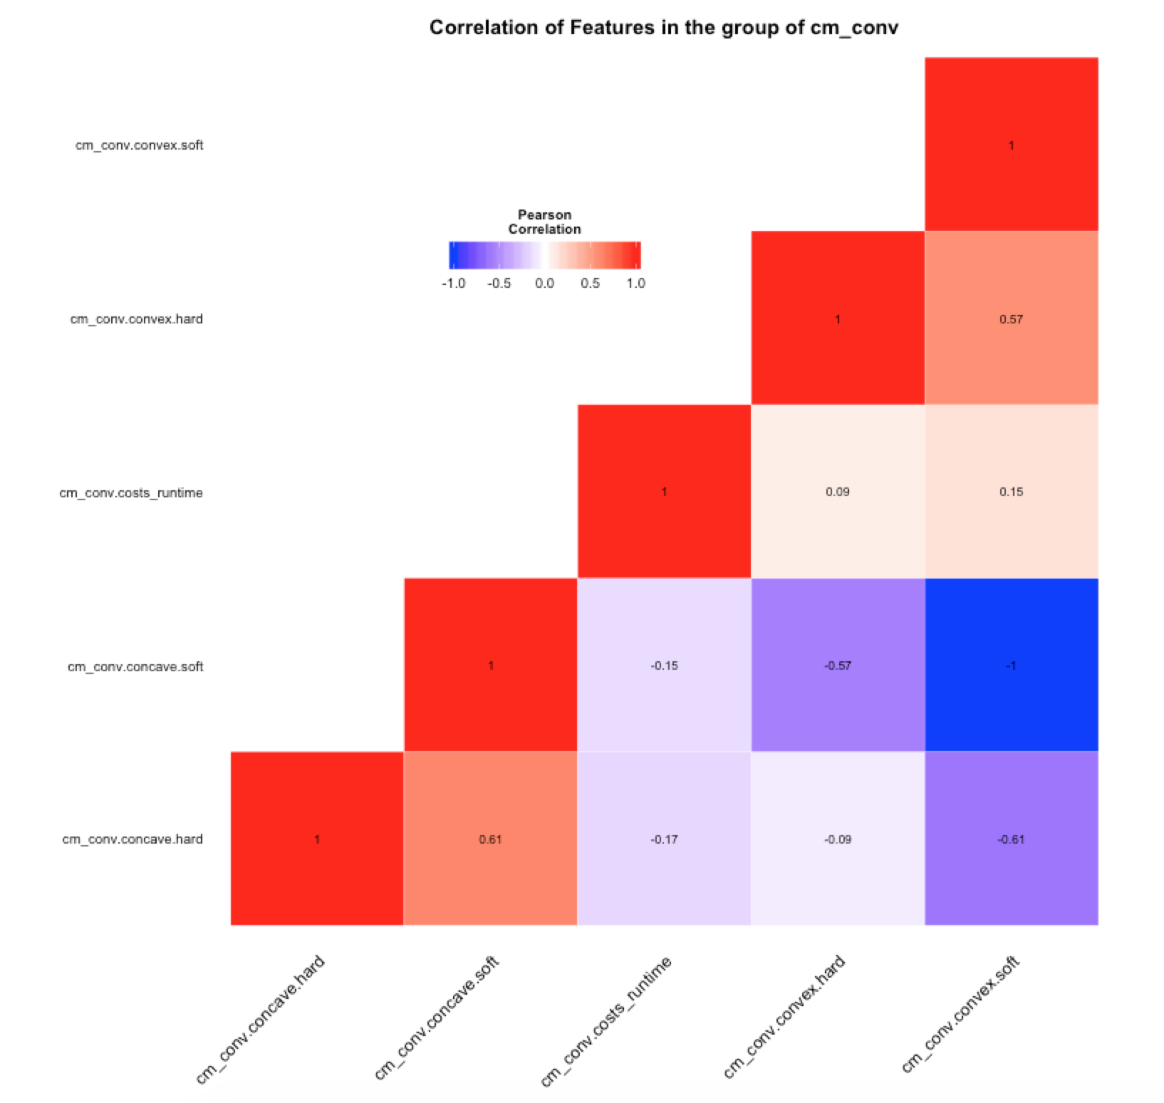
VIsualization
Scatterplots and ggheatmap of cm_conv features
The highest correlation
conv.convex.soft <> conv.concave.soft
Negatvie correlation

Slide 6
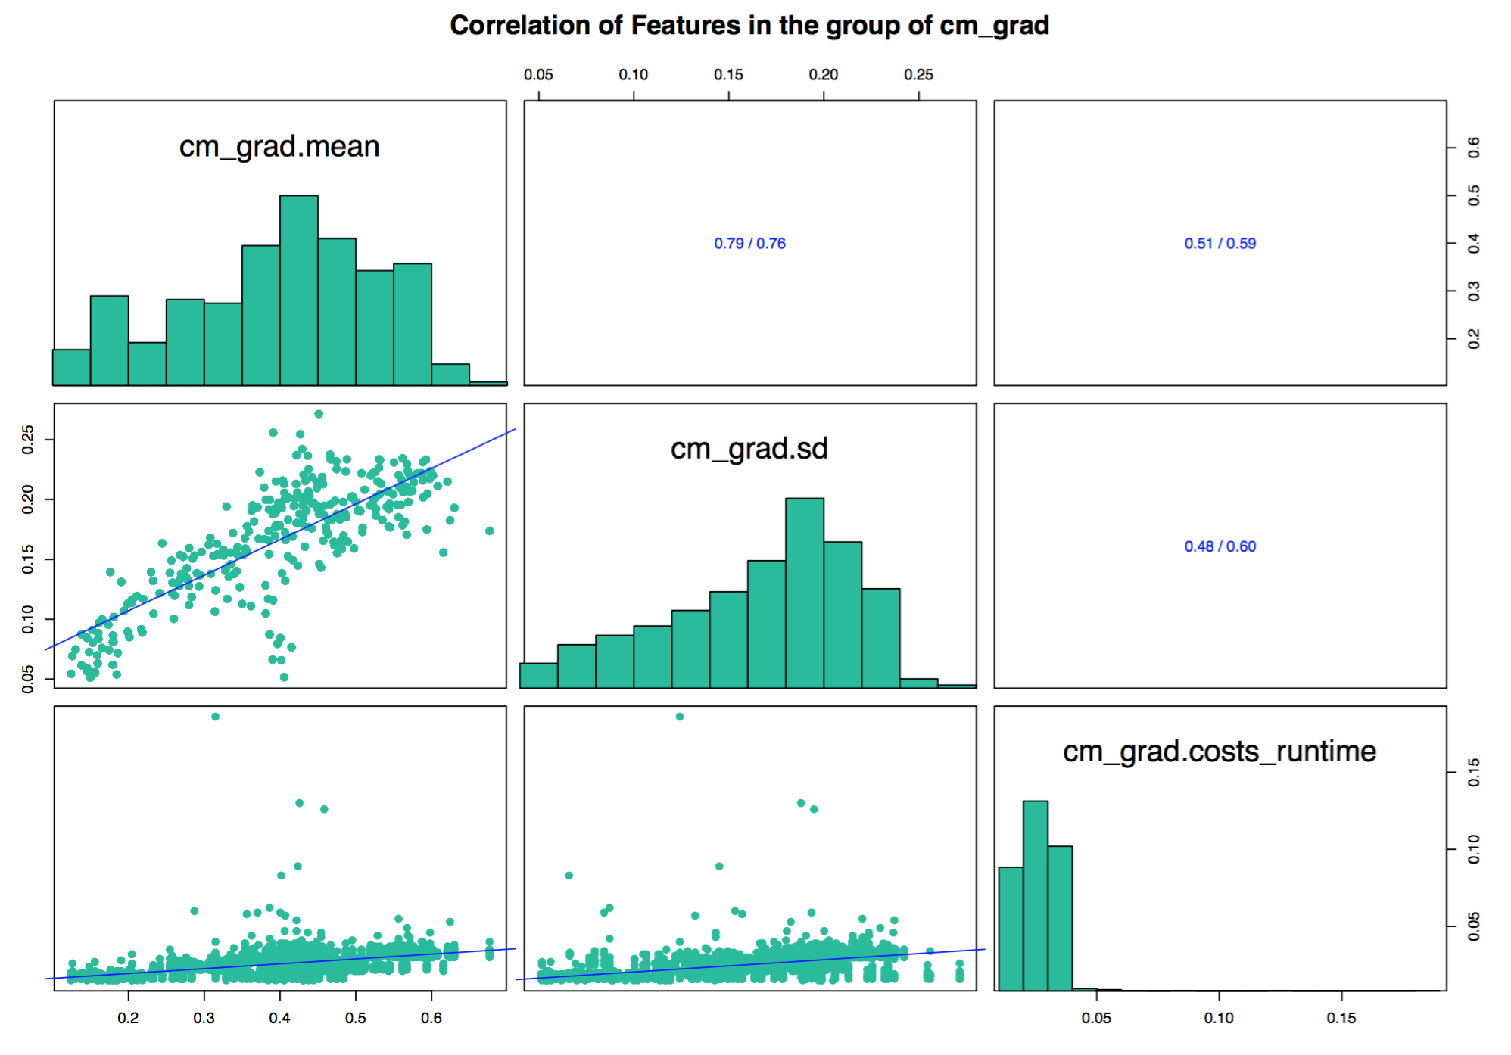
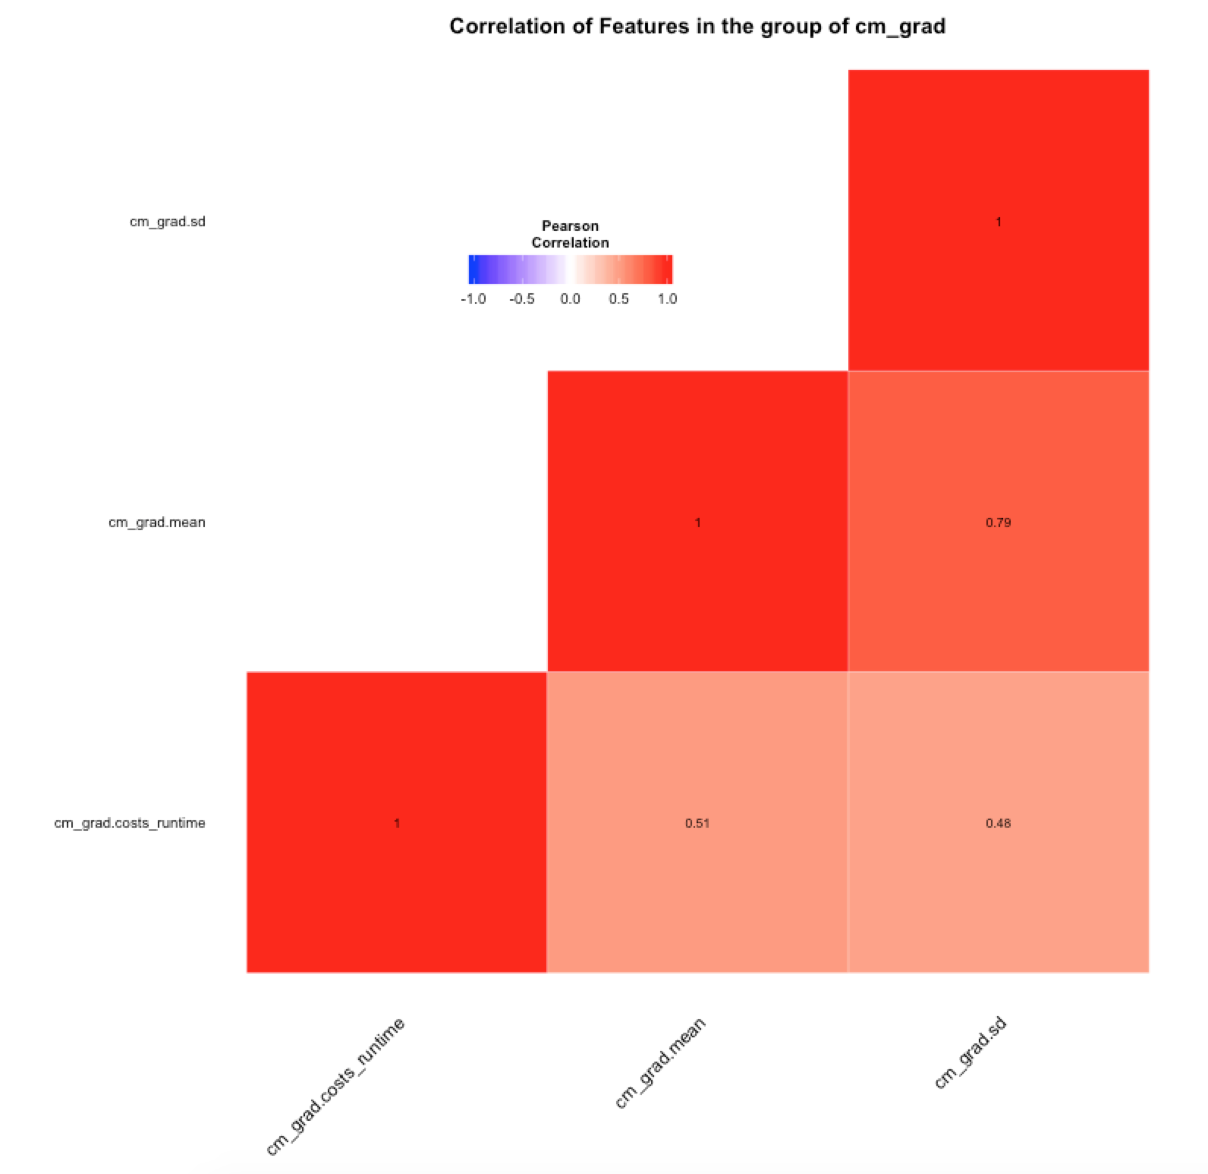
VIsualization
Scatterplots and ggheatmap of cm_grad features
The highest correlation
cm_grad.mean <> cm_grad.sd

Slide 7
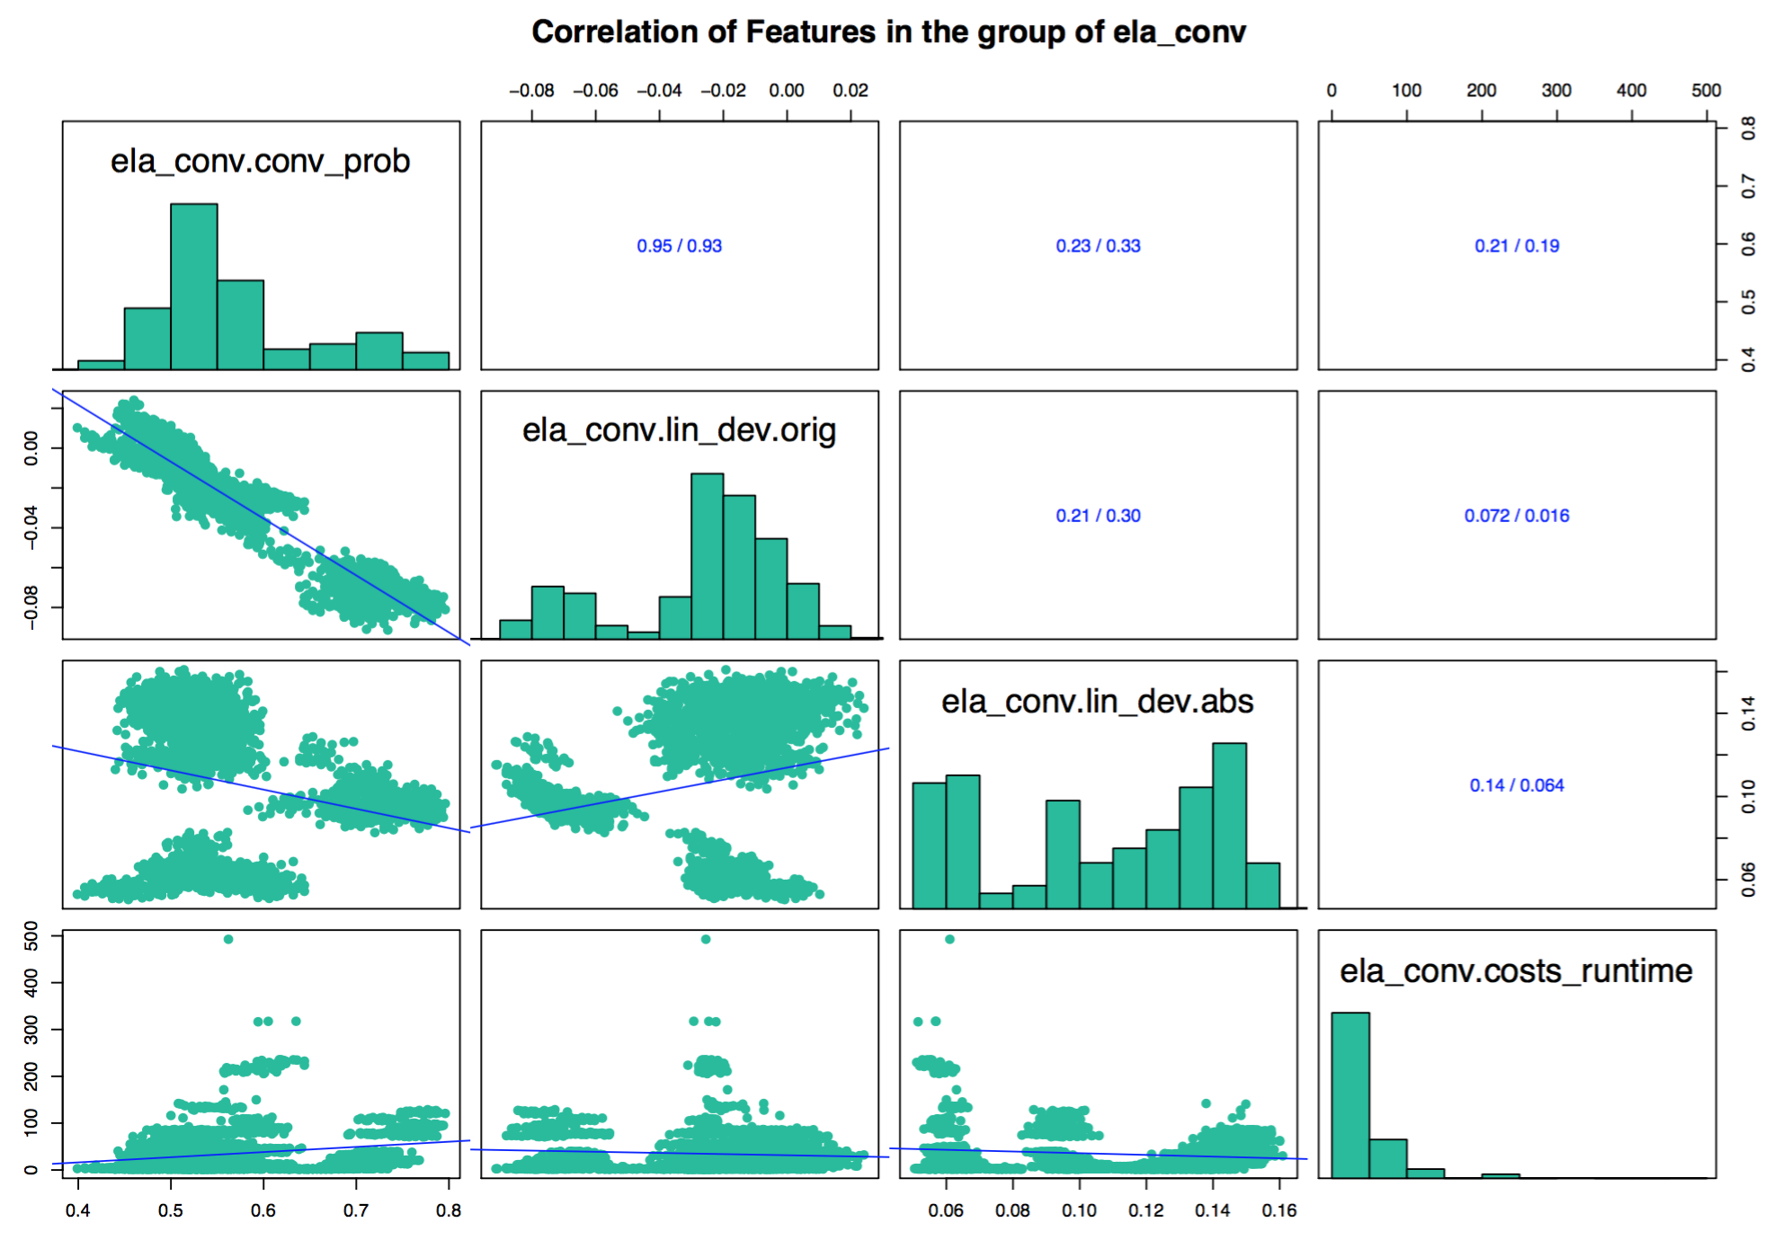
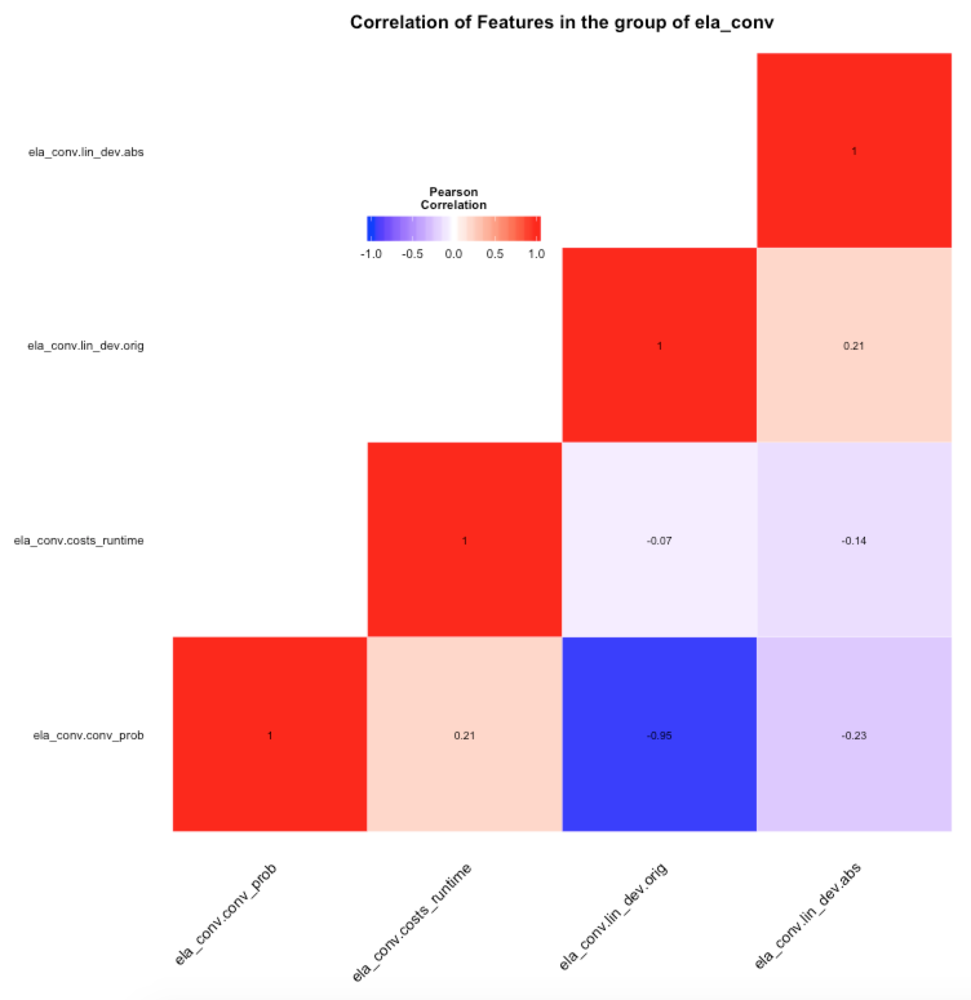
VIsualization
Scatterplots and ggheatmap of ela_conv
The highest correlation
ela_conv.conv_prob <> ela_conv.lin_dev.orig

Slide 8
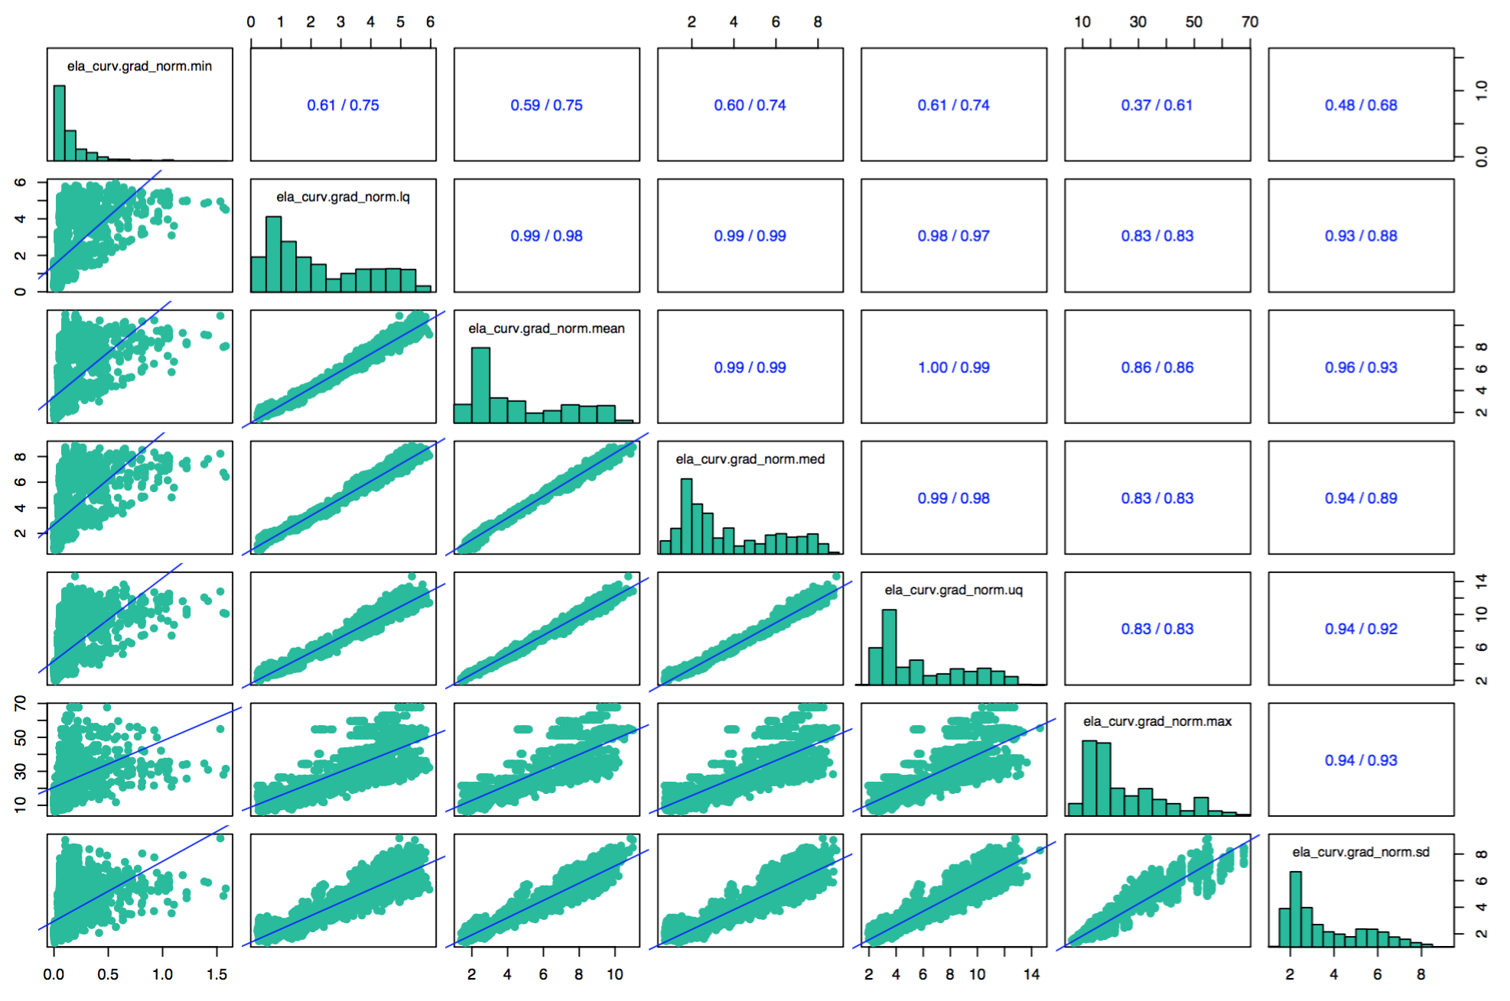
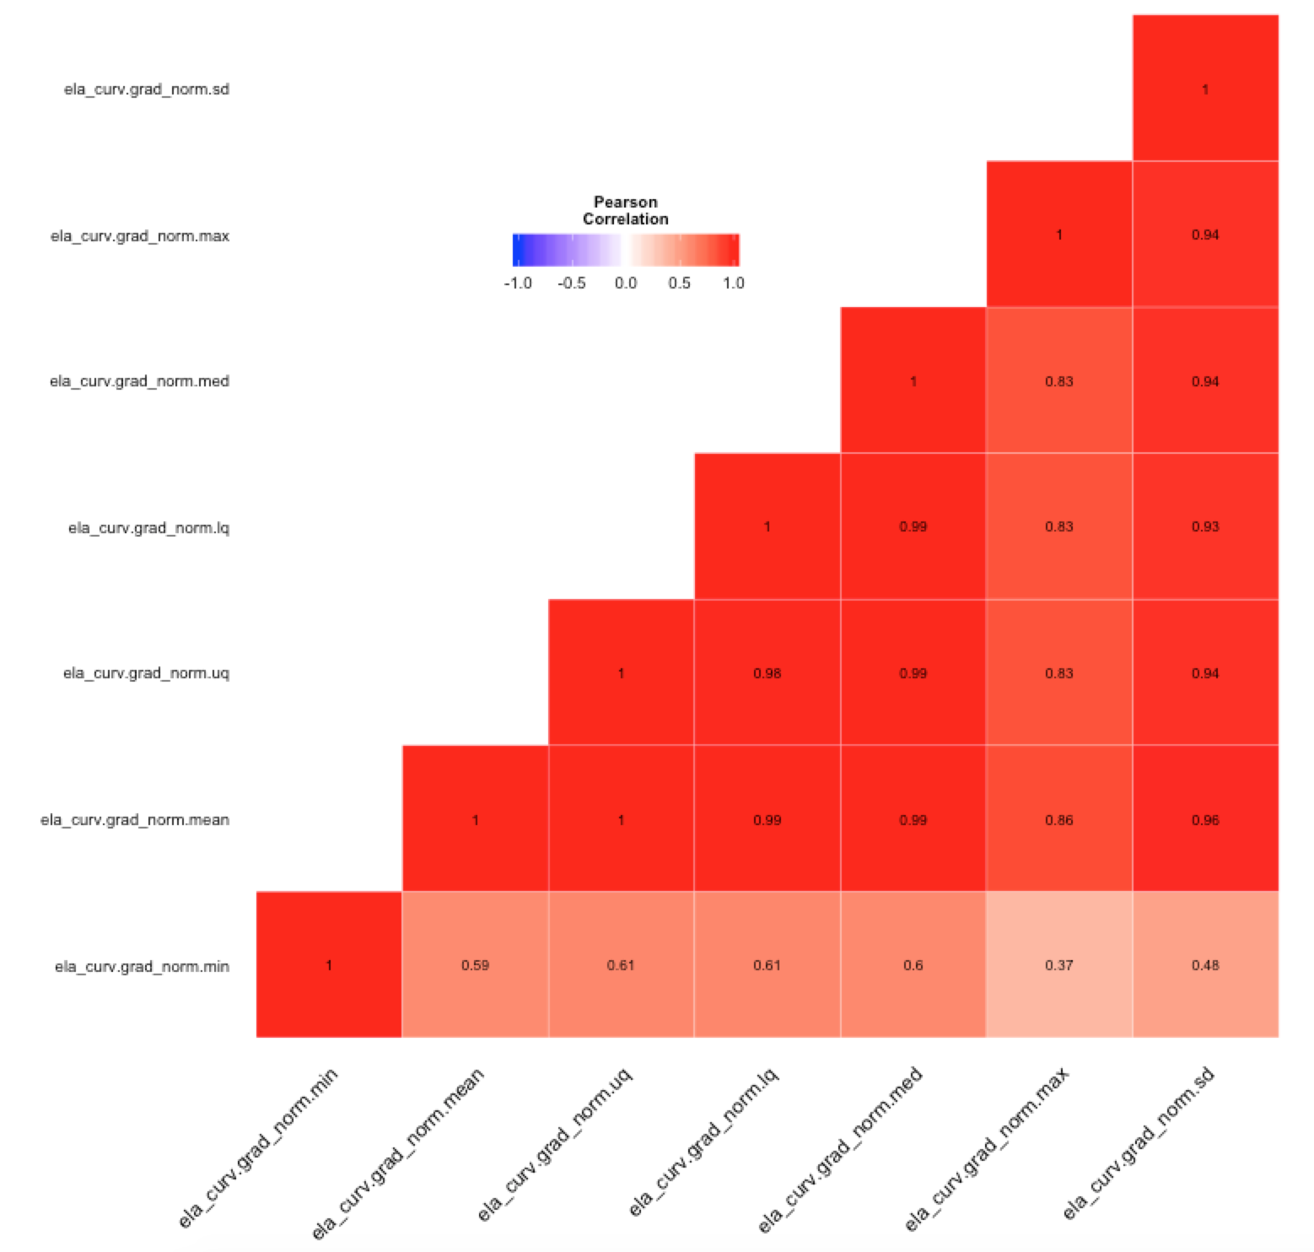
VIsualization
Scatterplots and ggheatmap of ela_curv
7 features out of 23 were selected for analysis
features from 2 column to 7 column have a strong correlation with each other

Slide 9
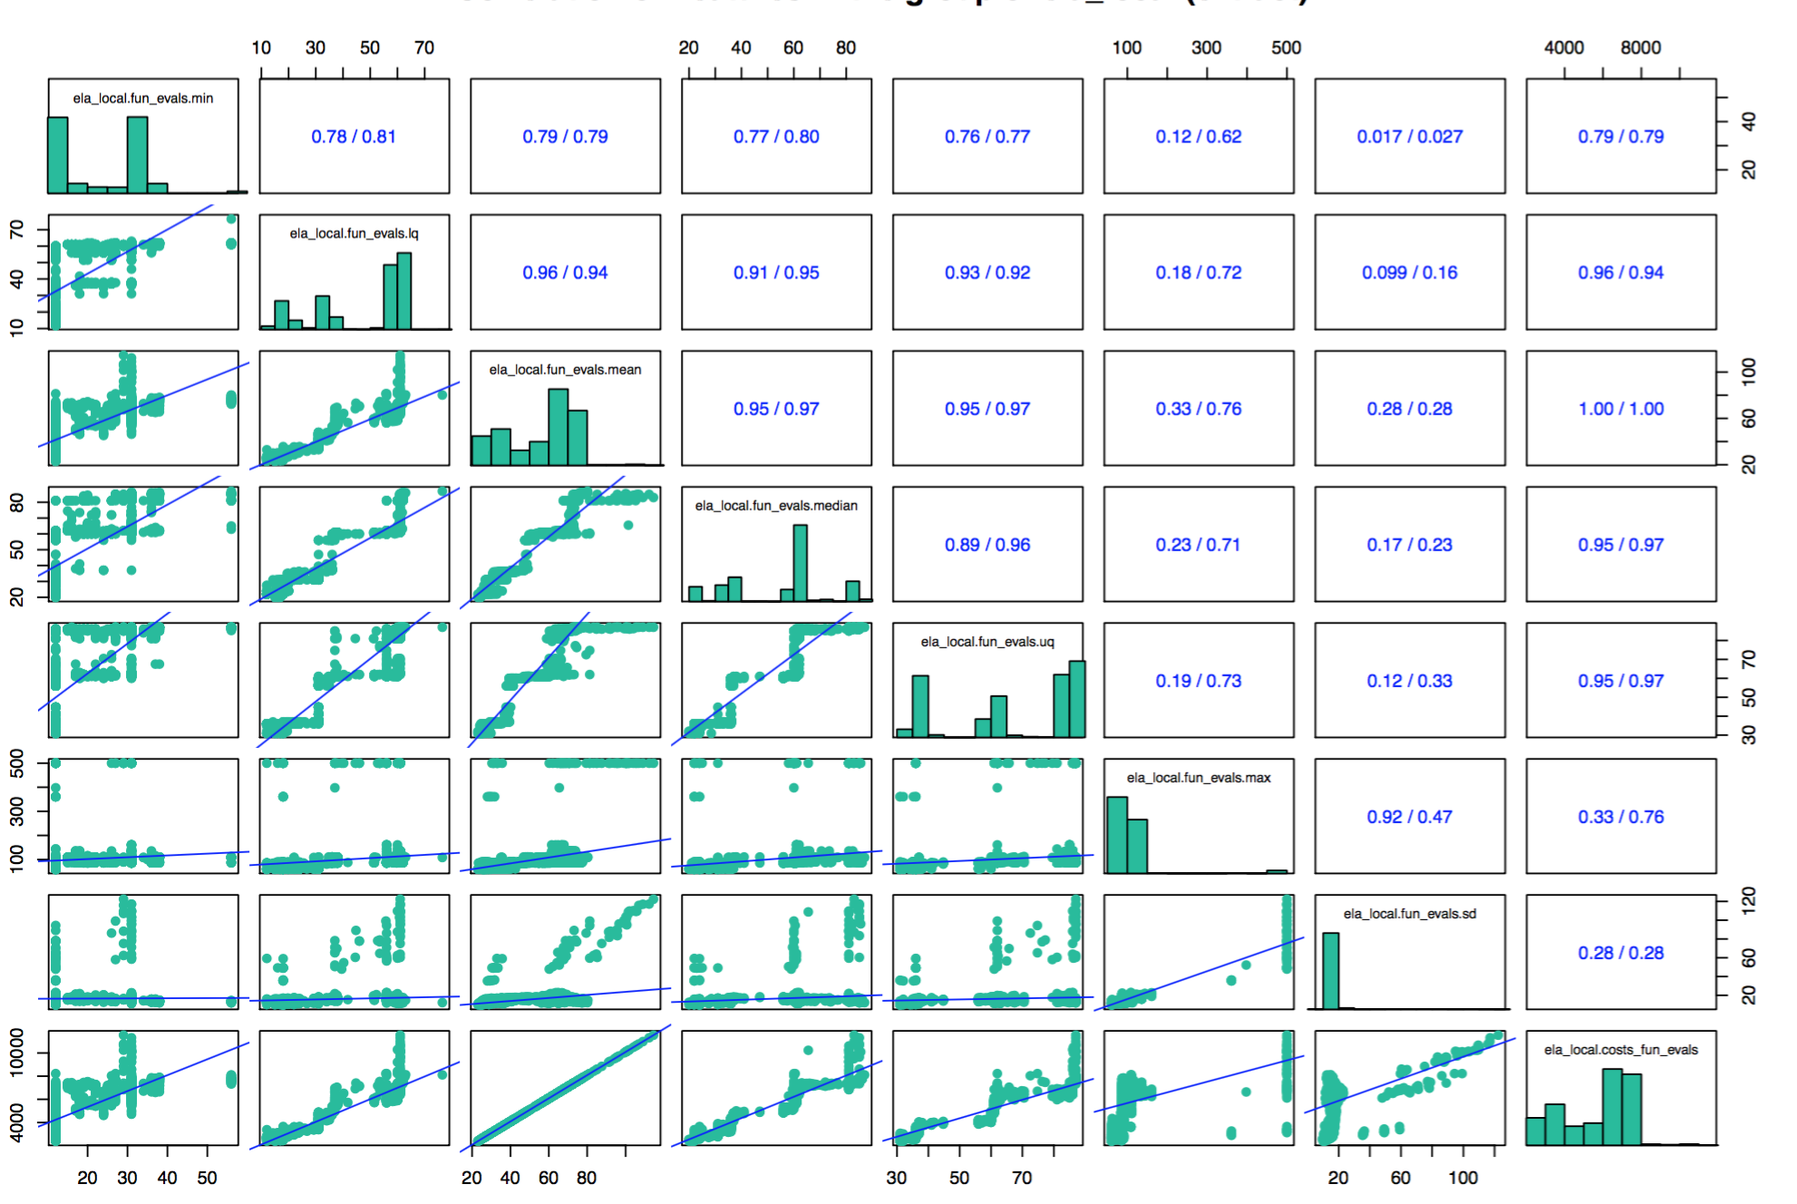
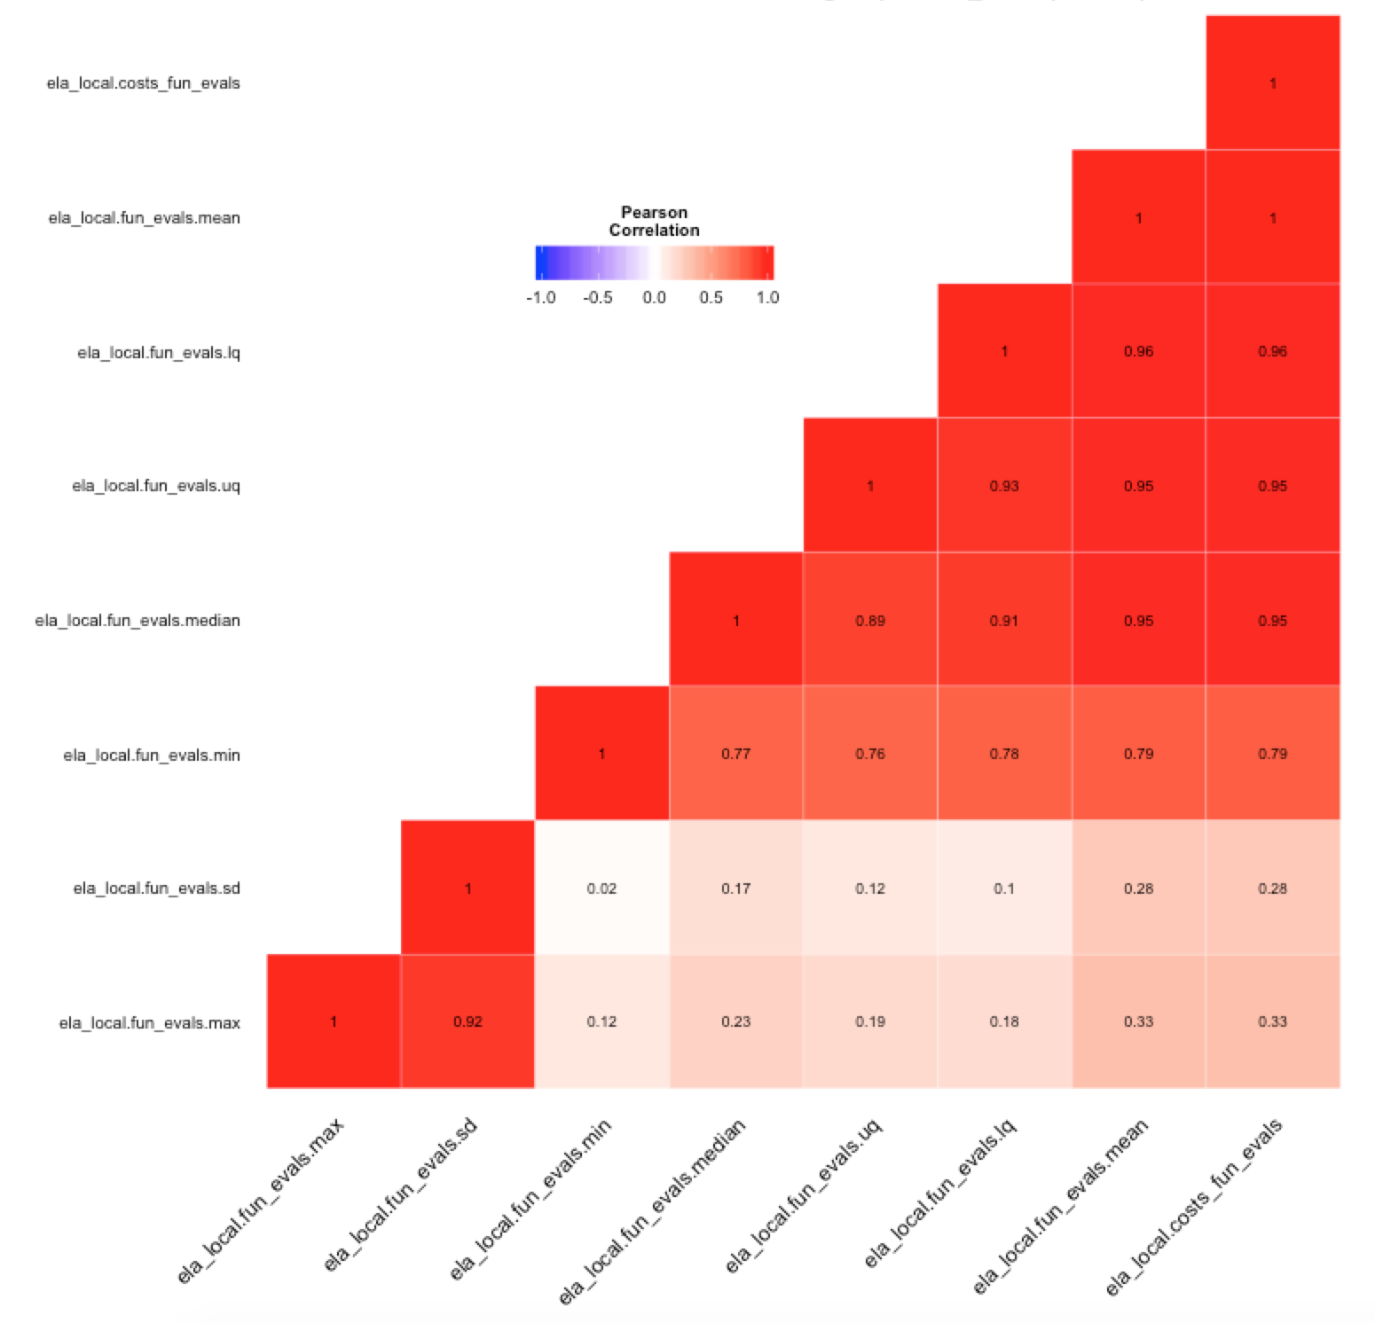
VIsualization
Scatterplots and ggheatmap of ela_local
8 features out of 14 were selected for analysis
features which have weak corrleation were discarded
fun.evals.lq, fun.evals.mean, fun.evals.median, fun.evals.uq and costs_fun_evals have high correlation with each other

Slide 10
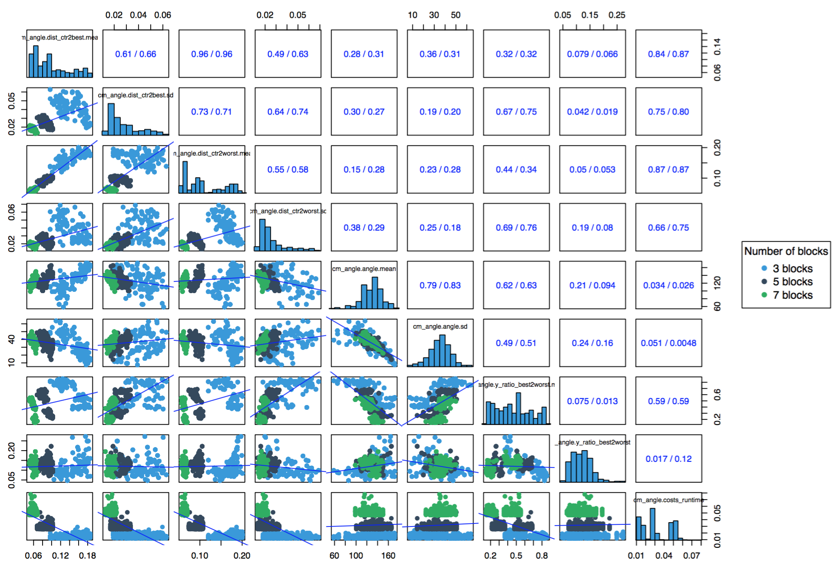
VIsualization
Scatterplots of cm_angle with block metadata
Block metadata influence on CM_angle features
Discovered particular patterns with block metadata

Slide 11
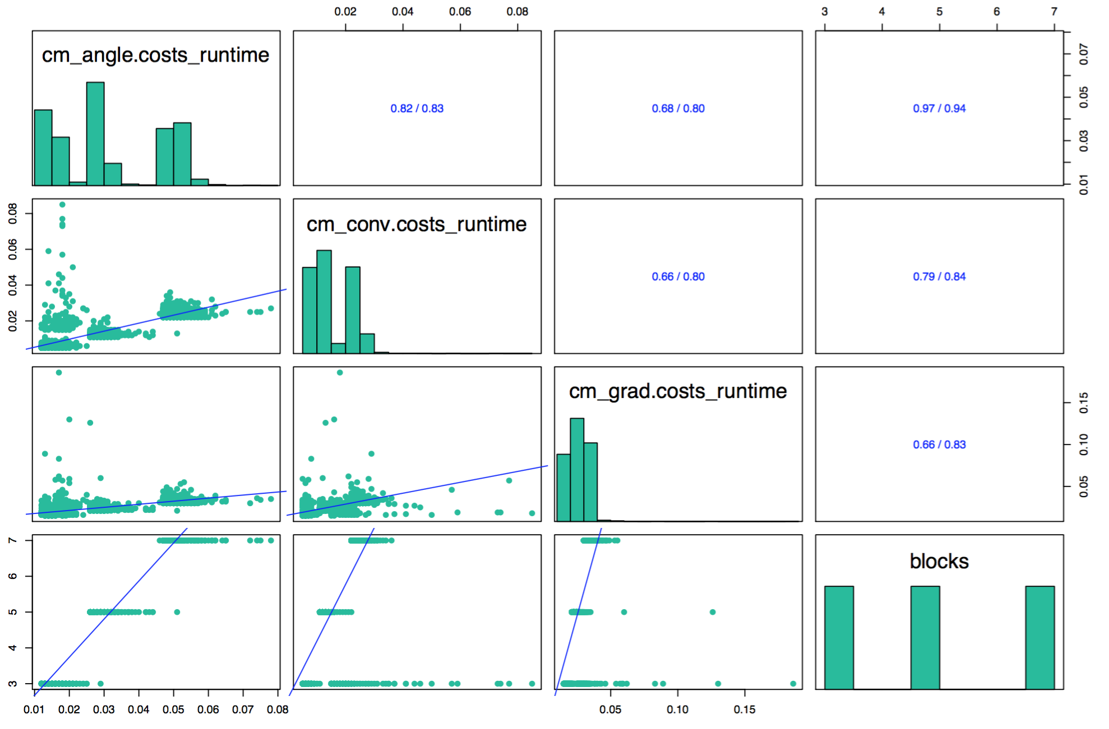
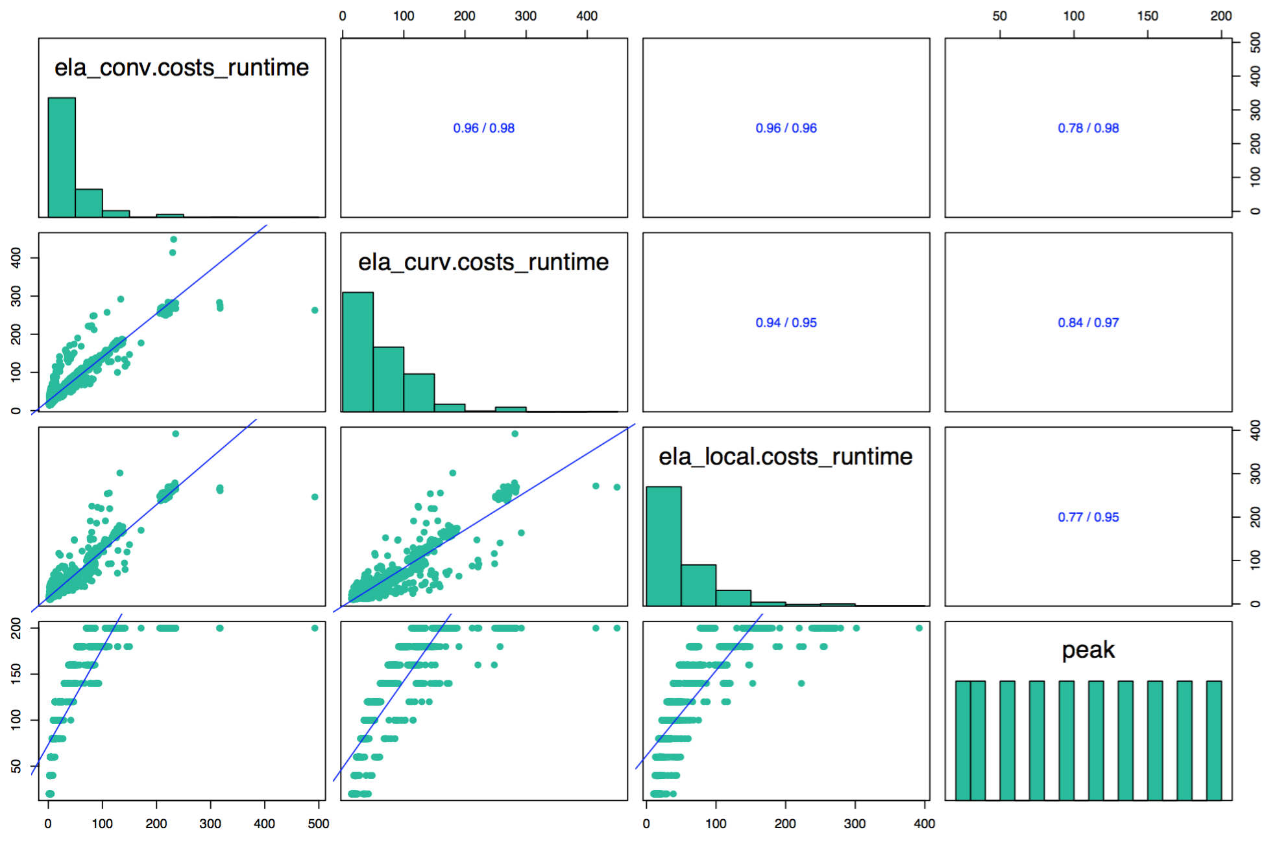
VIsualization
Other findings within feature-group
CM functions with blocks
ELA functions with peak
Correlation between functions and metadata
Increasing the number of blocks lead to increase the cost of CM functions
the cost of ELA functions are increased with the number of peak

Slide 12
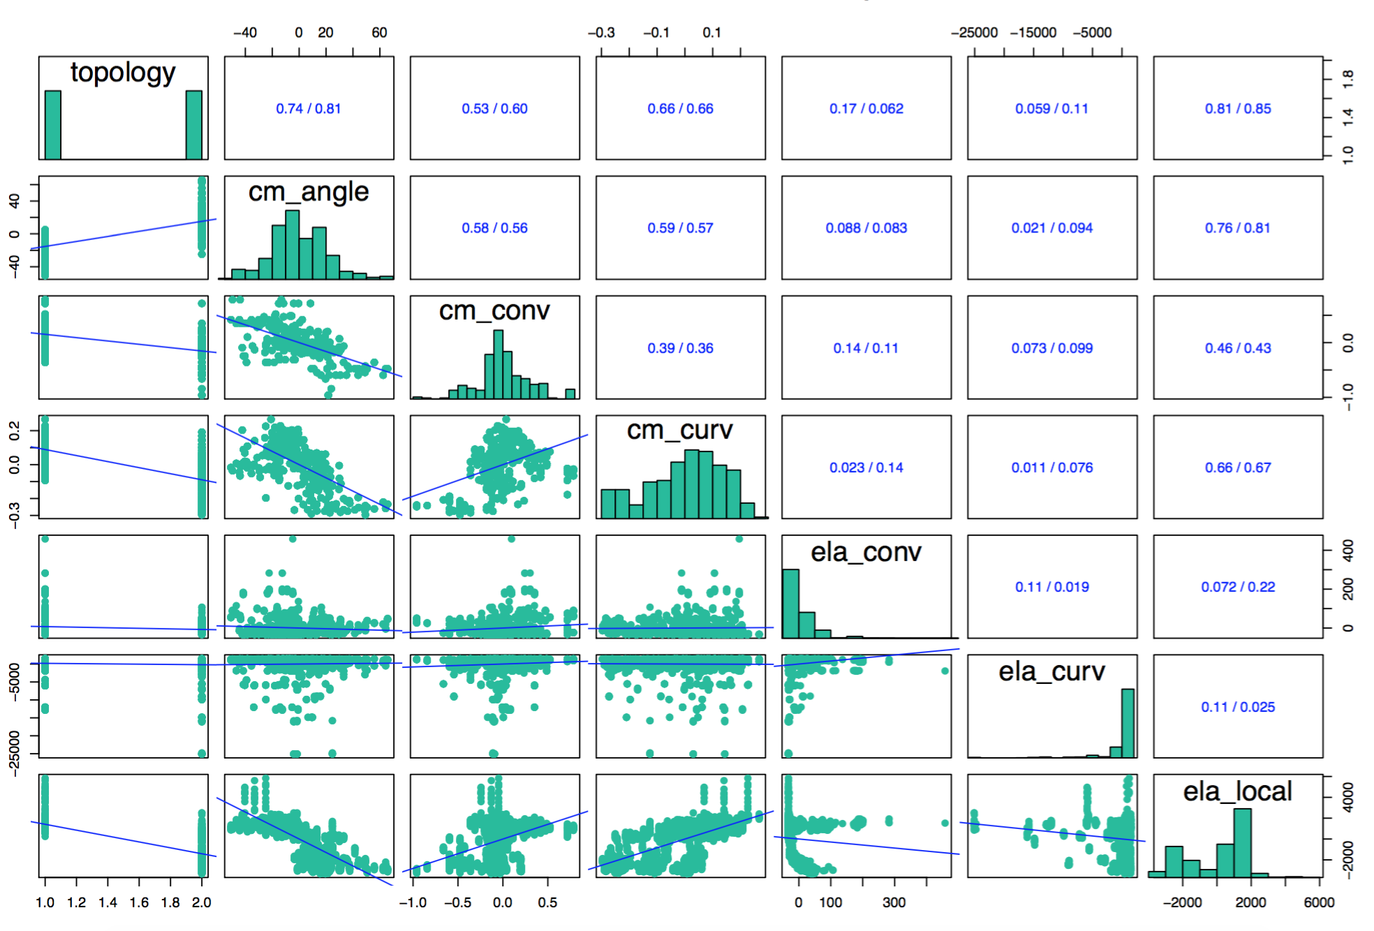
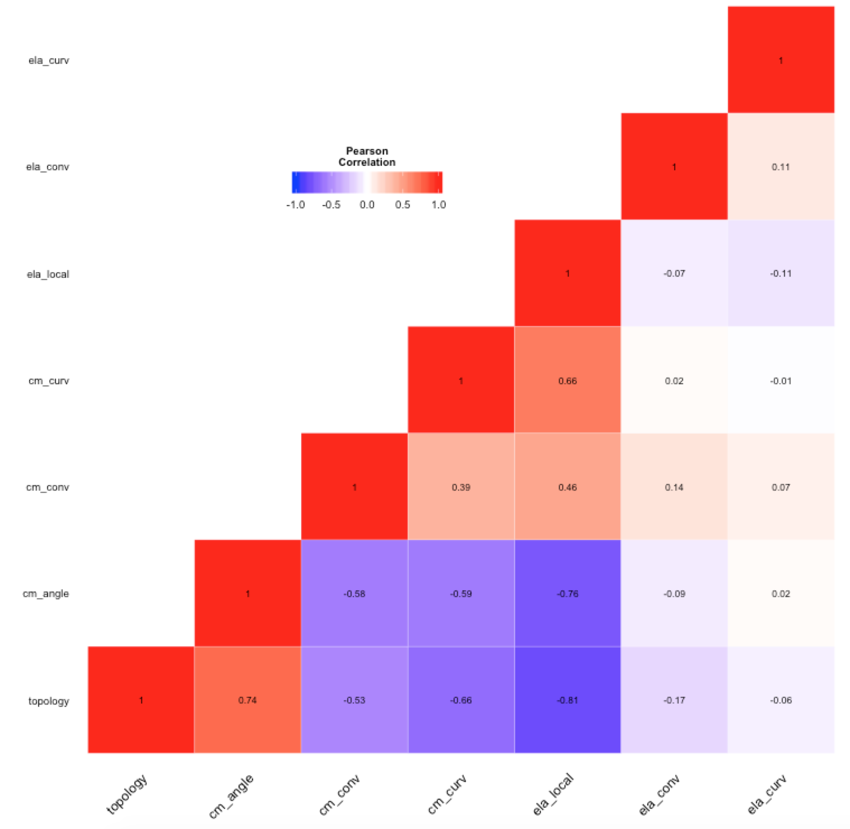
VIsualization
Scatterplots and ggheatmap between each group
Principal component analysis is used
First PCs are included to cover as many variables as possible in one column
there are correlation between topology and both cm_angle(+) and ela_local(-)

Slide 13
Thank you for your attention
Yongsun park (425844)

